Slide 1

Introduction to Software Engineering for Engineers
Team Presentation

Slide 2
Agenda
Behind the name
Meet the Team
Topic of concern
Roles delegated
Communication
Plan ‘B’

Slide 3

Behind the name
Sutra
Droid
- a Sanskrit word
- means a set of stringent rules
Are you up for some ‘Sutras of the Droids’?

Slide 4
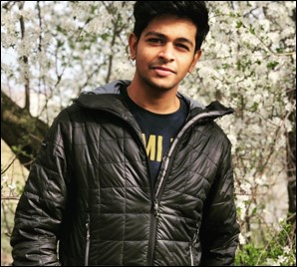
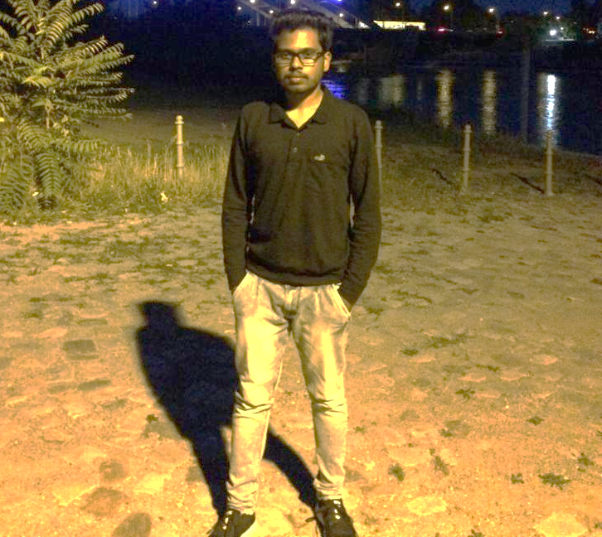
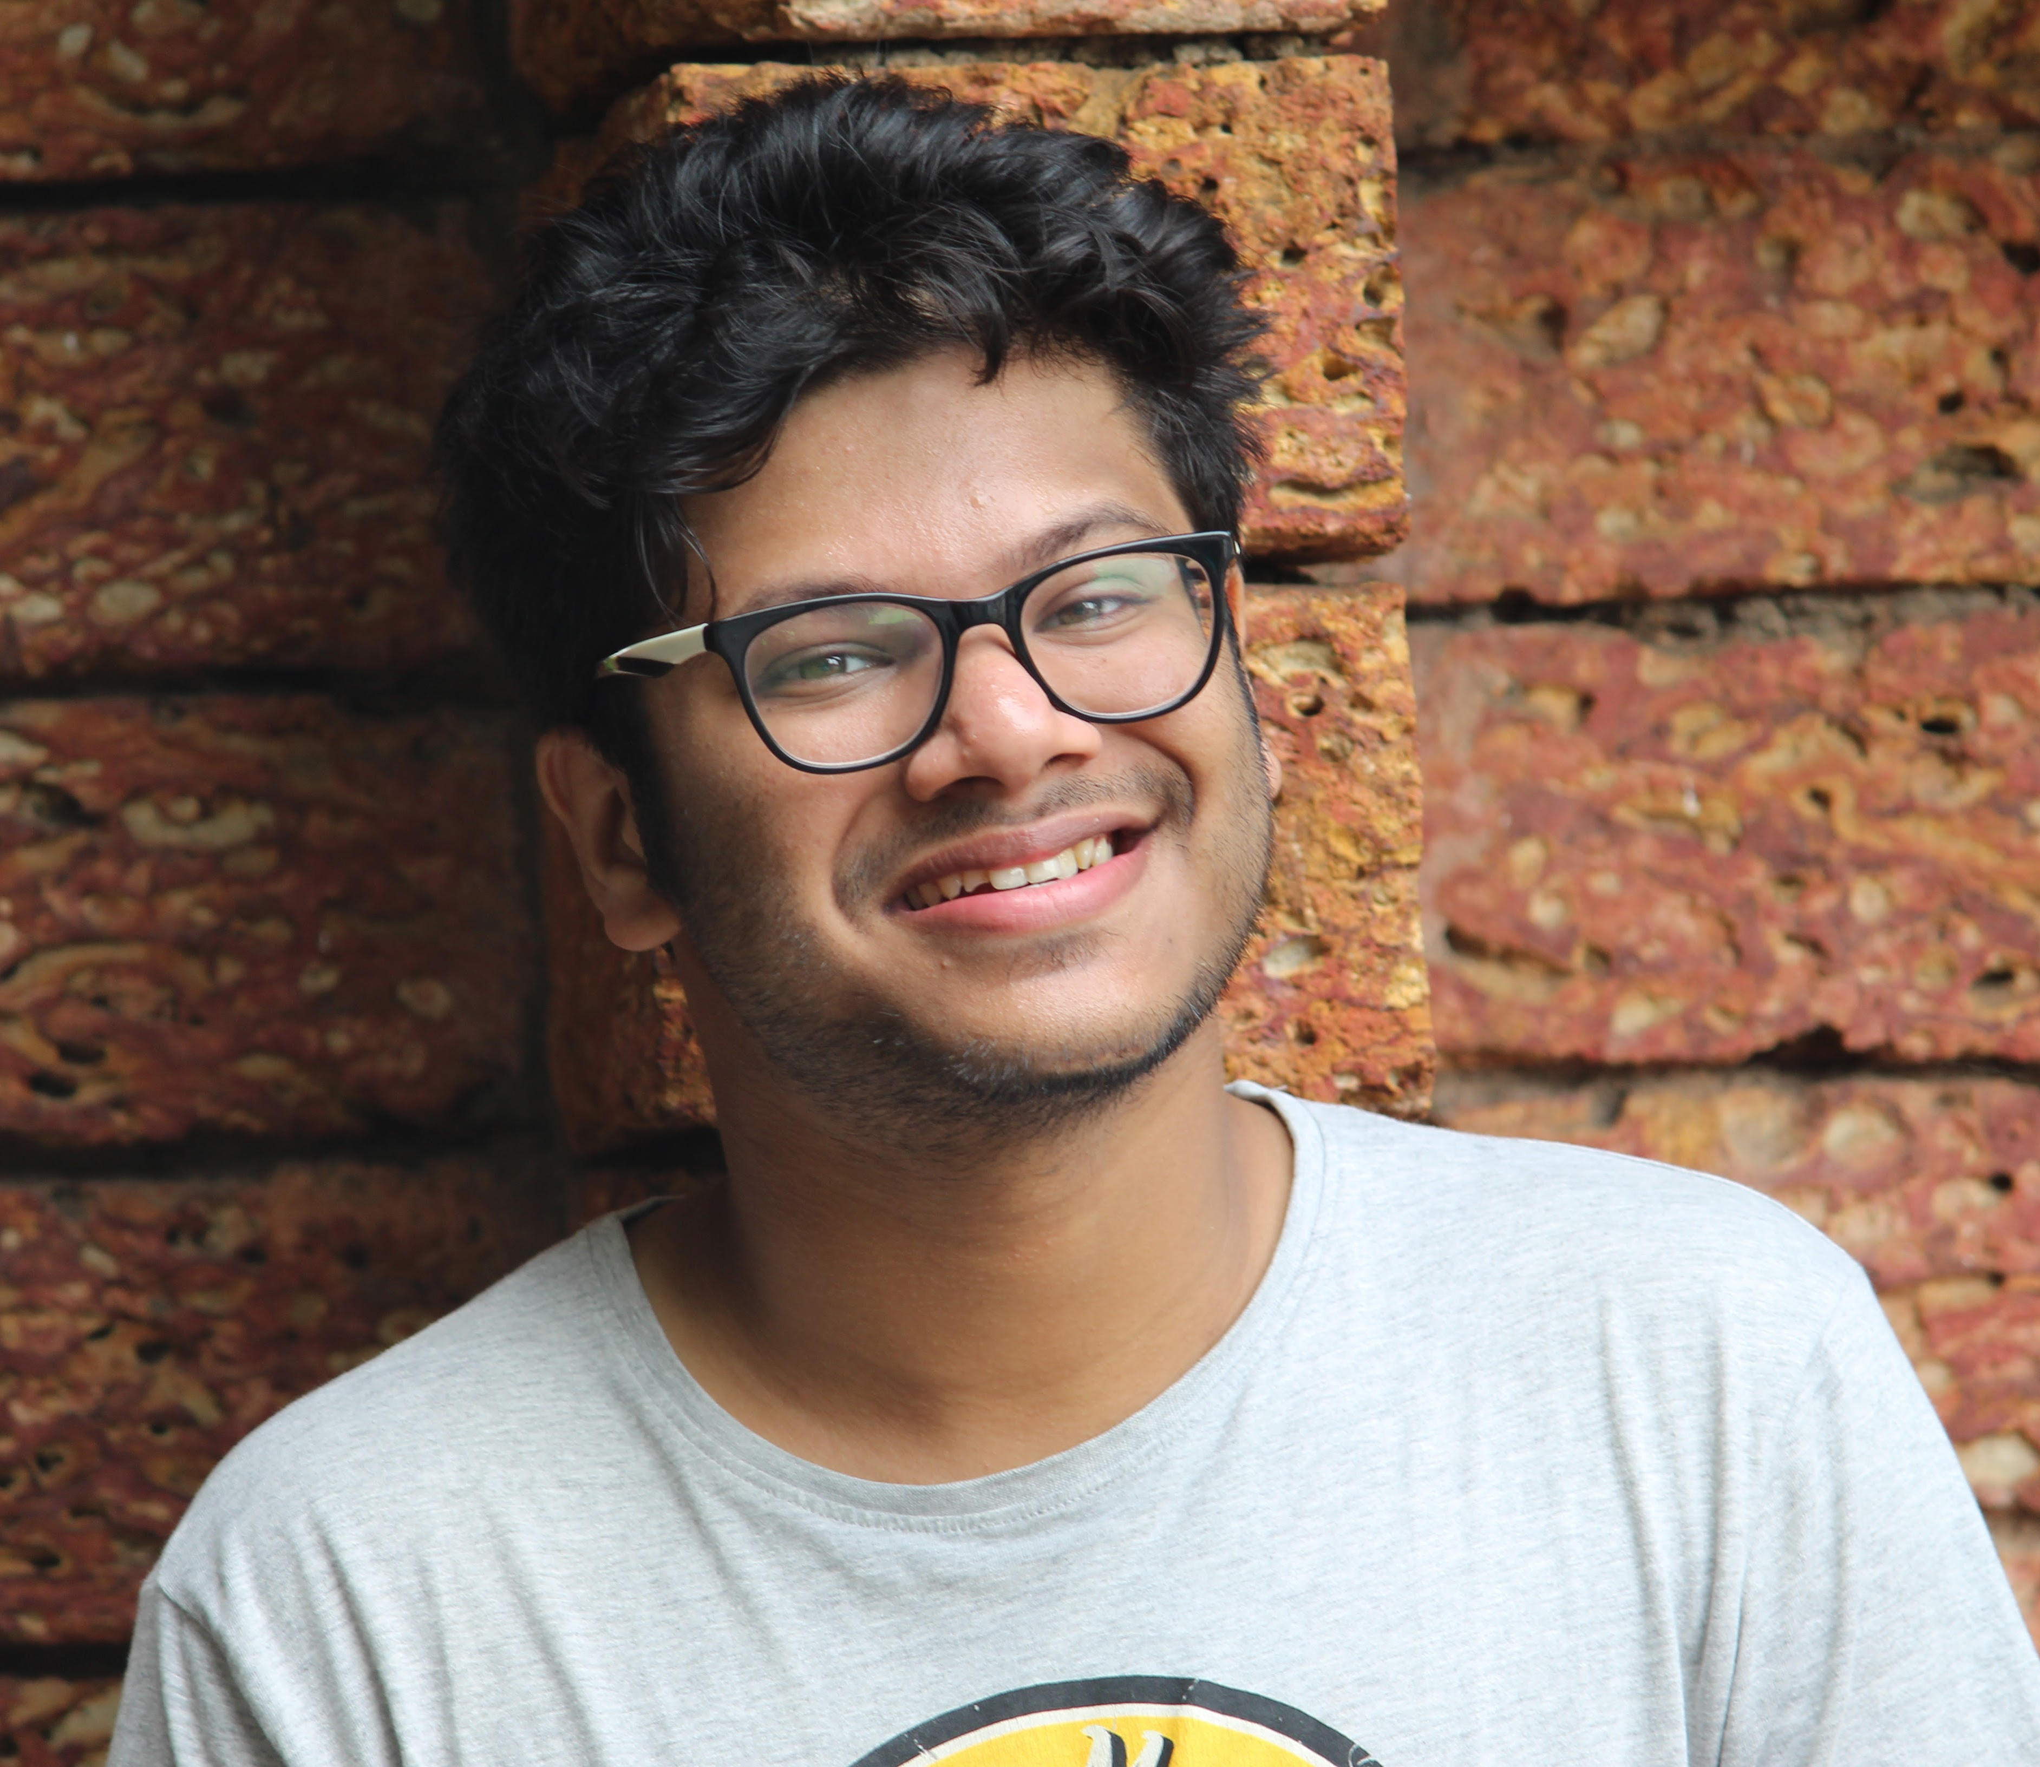
Meet the Team
Adarsh Raghoothaman
Rijin Shaji
Viju Sudhi
wants to be part of a dynamic team and prove his team-player skills
excited to explore Android App Development and its auxiliaries
wants to learn more about the entire software development process
delighted to be part of the first Agile software development project
wants to relive the professional scrums earlier attended
immense learning curve for basic Java and Android development

Slide 5

Topic of concern
Bird Tracking
helps to gather information about birds
helps to add occurrence of birds – location, time and activity
extended support for the user – be it, expert or beginner

Slide 6
Roles delegated
Application Design
Database Management
Blog Design and Content
A
Application development
R
V
Legend
A - Adarsh Raghoothaman
R - Rijin Shaji
V - Viju Sudhi

Slide 7
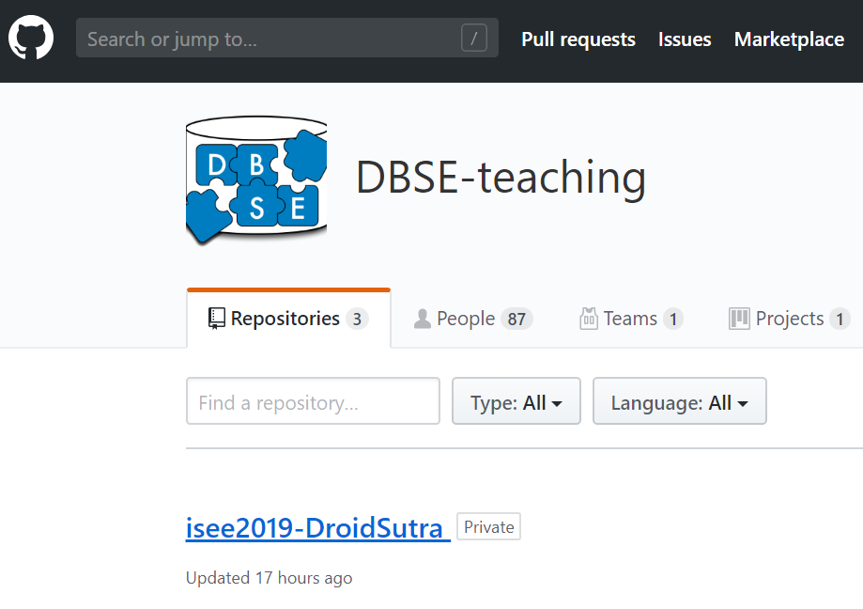
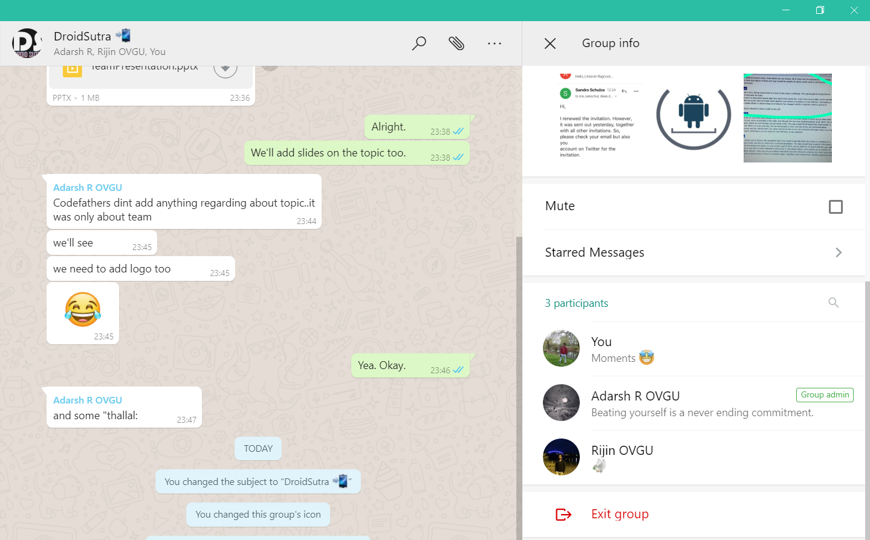

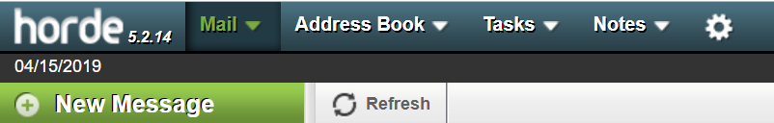
Communication
026
GitHub
Mail threads
Campus House Room No. 026
WhatsApp Group

Slide 8





Plan ‘B’
When Plan ‘A’ fails
1
Shift roles flexibly
2
Go for the ‘Re-’s : Redesign and Reinvent
3
Modularize and Prioritize

Slide 9

Thanks for your attention ☺
adarsh.raghoothaman@st.ovgu.de
rijin.shaji@st.ovgu.de
viju.sudhi@st.ovgu.de

